Slide 1
Structure of a C Program
Course Leader:
Jishmi Jos Choondal

Slide 2
Objectives
At the end of this lecture, student will be able to
Explain the structure of a C program
Explain the building blocks of C programs

Slide 3
Contents
Introduction to C programming
Tokens, keywords, identifiers and constants
Expressions, Blocks and Statements

Slide 4
Program Development Cycle
Analyze the problem
Design the solution algorithm
Design the user interface
Write the code
Test and debug the program
Complete the documentation

Slide 5
C Language
Developed by Dennis Ritchie at Bell Laboratory
Procedure oriented language
Evolved from B, which evolved from BCPL

Slide 6
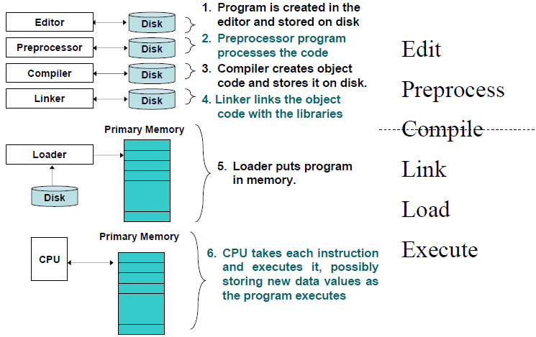
Phases of C Programs

Slide 7
Structure of a C Program
Documentation section
link section
definition section
Global declaration section
main() function
Braces
statements
…..
user defined functions
/*This is a program to calculate perimeter of circle */
#include<stdio.h>
#define PI 3.14
float area(float);
int main(int argc, char *argv[]){
printf(“Perimeter of circle with radius %f is %f\n”,2.0f,area(2.0));
}
float area(float radius){
return 2*PI*radius;
}

Slide 8
main() Function
main() is a part of every C program
C programs contain one or more functions, one of which must be main
Every program in C begins executing at the main()
Block – the pair of braces {} and the portion of program between the braces
Statement terminator – every statement must end with a ;

Slide 9
Question
We all know one or more human languages. What is a human language made up of?
Alphabets
Words
Sentences
Paragraphs
A computer program
Character set
Tokens
Statements
Functions

Slide 10
Character Set
Alphabets
Lower case letters – a to z
Upper case letters – A to Z
Digits
0, 1, 2, 3, 4, 5, 6, 7, 8, 9
Special characters
~ % | @ + < _ - > ^ # = & $ / ( * \ ) ′ : [ “ ; ] ! , { ? . }

Slide 11
C Tokens
C tokens : the smallest individual units
Keyword – float, while, for, int,….
Identifier – main( ) , amount, sum, …
Constants – -13.5, 500, …
Strings – “ABC”, “MCA”, …
Operators – + - * % …
Special Symbols – [ ] { }…

Slide 12
Keywords used in C
Fixed meaning, cannot be changed
Reserved words
Cannot be used as a variable or function name
Basic building blocks
All in Lowercase

Slide 13
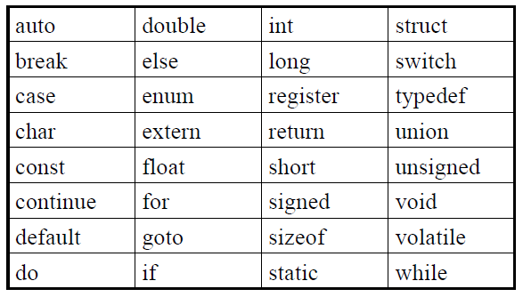
Keywords used in C contd.

Slide 14
Identifiers
Name given to a function or variable memory location
An identifier is a series of characters consisting of letters, digits and underscores “_”
Should start with a letter or underscore
Can be any length
only the first 31 characters are required to be recognized by ANSI C compilers
Keep identifiers 31 characters or less for portability and fewer problems

Slide 15
Identifiers - Examples
CAN
contain a number elsewhere h2o
be of mixed cases Xsquared
contain or begin with an underscore _height_
CANNOT
start with a number 2i
contain any arithmetic operators r*s+t
contain any other punctuation marks #@x%£!!a
be a C keyword struct
contain a space my var

Slide 16
Constants
Fixed values
Does not changes during execution of program
Numeric constant – Integer (decimal, octal, hexadecimal) and Real
Character constant :
Single character constant
String constant
Backslash character constant

Slide 17
Escape Sequence
Escape character – backslash \
When encountering a backslash in a string, the compiler looks ahead at the next character and combines it with \ to form escape sequence

Slide 18
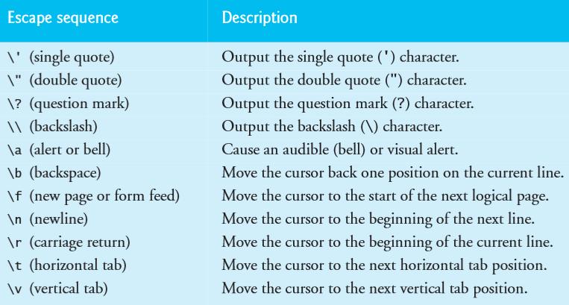
Common Escape Sequences

Slide 19
Summary
All C programs follow a predefined structure
Words of a computer programming language are known as Tokens
They can be Reserved Keywords, Identifiers, Operators and Constants
Expressions are a collection of operands and operators
Statements are always terminated
Statements can be composed of declarations, expressions, control structures or a function call

Slide 20
Further Reading
Allain, A. (2005) Introduction to C, available at http://www.cprogramming.com/tutorial/c/lesson1.html (accessed 22 July 2014).
Kernighan, B. W. and Richie, D. (1992) The C Programming Language. 2nd ed., New Delhi:PHI.

